Slide 1
Introduction to CNN

Slide 2
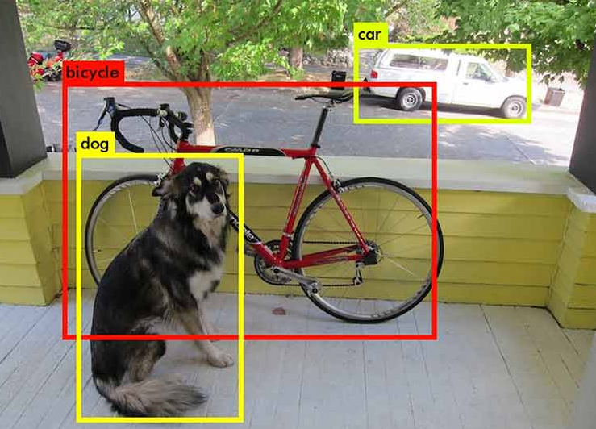
What is Convolutional Neural Network
It is a Deep Learning algorithm which can take input as an image and assigns learnable weights and biases to various objects in the image to differentiate one from the other.
It is a neural network that suits for image classification and object detection problem statements.
Can’t we use simple neural networks on Images ?

Slide 3
Disadvantages of Simple Neural Network
Size of input layer:
Images can big, these days smartphones can even capture 8k images. Suppose I have a dataset with image size (1000,1000) i.e.., 1000 pixels each on vertical and horizontal.
Flatten (1000,1000) Image results in vector size of 1 Million which is unimaginably large and can explode the size of neural networks.

Slide 4
Disadvantages of Simple Neural Network
2. Feature Learning:
As Image is flattened, each pixel acts as an input feature i.e.., we will be able to predict correctly only if the given image has the same object placements as in training.

Slide 5
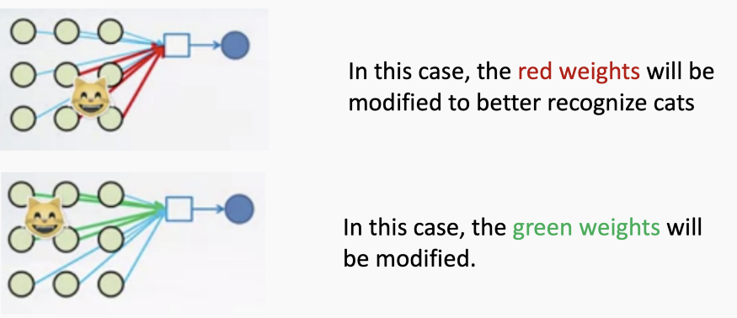
Example
If we train a neural network using pictures of the cat placed on the top left of the image then the weights of the neural network associated with the top left part of image only learn the pattern of Cat.
What if I show my neural network an Image of a cat placed on bottom right ? It would fail to classify it.
This problem is also called “Translation Invariance”, Simple Neural Networks fail to achieve this!

Slide 6

How CNN solves this
Convolutional networks achieves “Translation Invariance” by using shared weights.
CNN uses the same set of weights to look at the whole Image traversing from top left to bottom right.

Slide 7
Convolution Operation

Slide 8
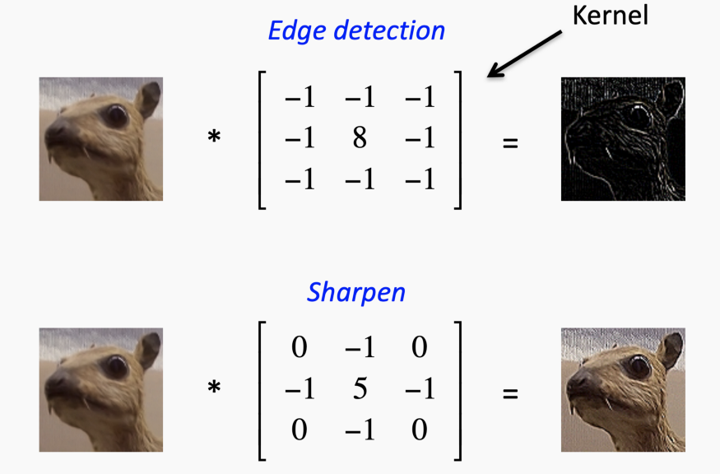
Filters
Filters also called Kernels, are used to enhance the features in an Image by element wise multiplying a matrix over the whole image.
Its a matrix, when multiplied over whole image extracts features.

Slide 9
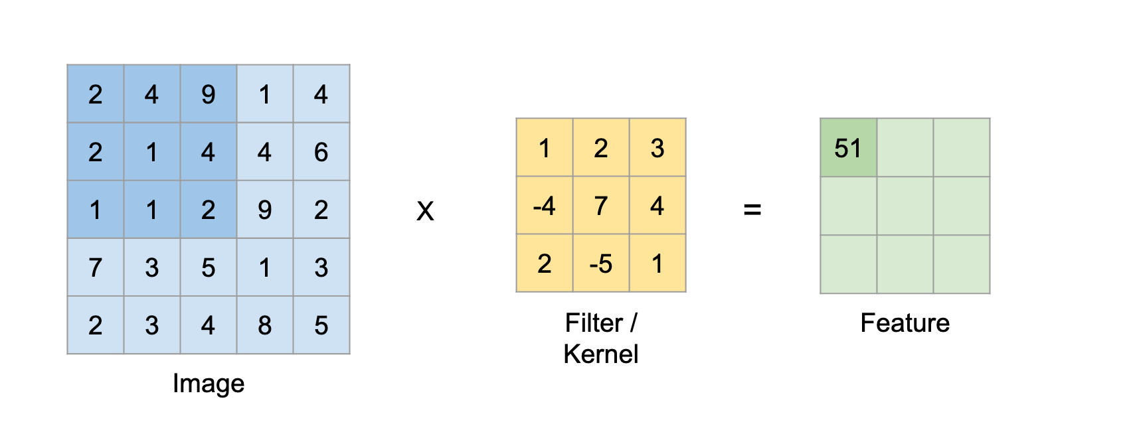
How Convolution works ?
Place the filter on top of Image and perform an element wise product which results in 9 numbers.
Add up all the numbers which will be placed on the resultant matrix which is the output.

Slide 10
How Convolution works ?
3. Repeat the process by moving the filter all over the image from top left to bottom right and fill up the resultant matrix which is our final feature matrix.
4. If the filter learns to identify the pattern of the object it would be able to identify that object regardless its position in the image. Hence overcomes Translation Invariance.

Slide 11
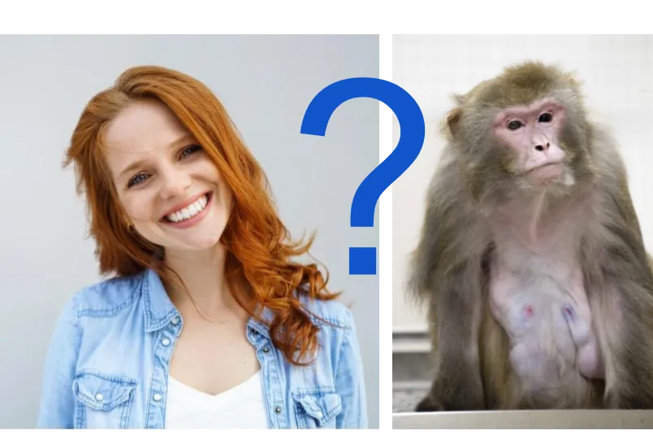
Need for Multiple Filters
One filter when convoluted on the Image would return in one feature map.
To extract multiple features from an image we need to use multiple filters.
The more filters we use, the more features it generates which increases the size of the network but helps better prediction.

Slide 12

Filter for RGB Images
The Images can be 3 dimensional as well, for example a colour image which has RGB filters as 3rd dimension.
In this case our filter should also be 3 dimensional to be able to perform an element wise product.

Slide 13
Filters as Weights of Network
Convolution neural network solves this by considering the Filter to be a matrix of learnable weights which will be updated while backpropagation.
The Feature generated by colvoluting images and filters are passed into activation function like Relu or Leaky relu.

Slide 14
Padding and Pooling

Slide 15
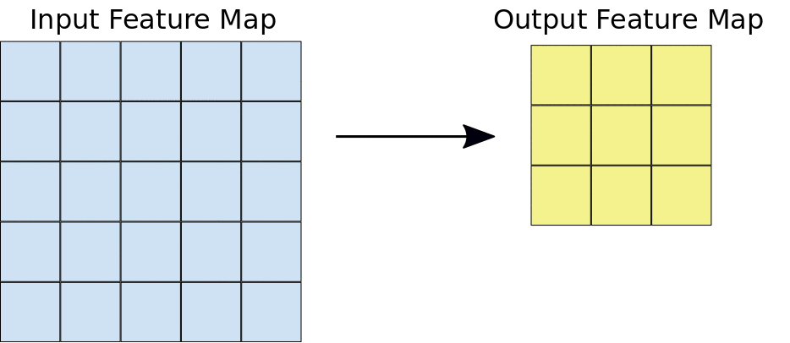
Issue with Convolution Operation
While traversing the learnable filter over image, the filter spends less time learning features in corners of image compared to center.
Filter might not detect the important features present in corners of the image.
Padding Helps us solve this issue.

Slide 16

Padding
Adds an extra frame of zeros to the image to allow for more space for the kernel to cover, Adding padding to an image processed by a CNN allows for more accurate analysis of images.
As Convolution operation decreases the size of
output feature map compared to input, Padding
here helps in enlarging the output feature map

Slide 17
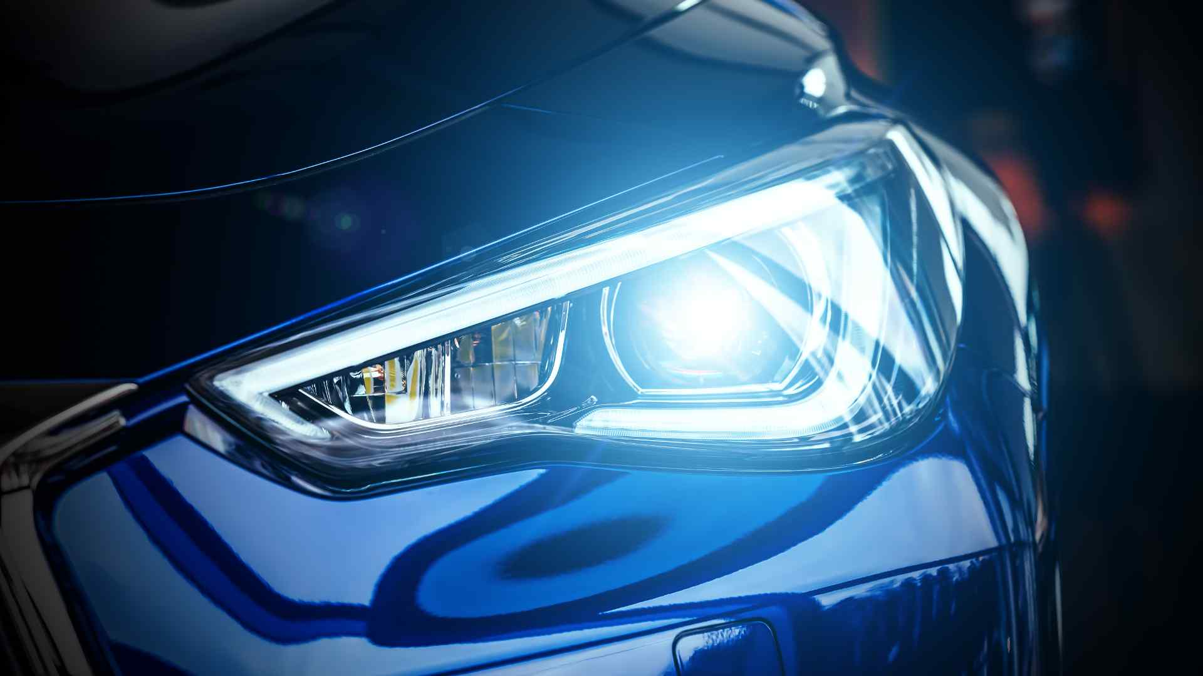
Pooling
Approach to down sampling feature maps by summarizing the presence of features in patches of the feature map.
Using pooling, selects the best feature and pass it forward leaving behind the rest signals in the surrounding region.

Slide 18

Pooling
Max pooling selects the highest signal in the feature map.
Average pooling takes the mean of all signals in the feature map.
“Max” Pooling is used in “Image Classification” problem statements.
“Average” Pooling is used in problem statements
like “Image reconstruction” or “Segmentation”.

Slide 19
Data Augmentation

Slide 20

Need For Data Augmentation
Even after using a proper architecture and methods to train the models we do not get satisfactory results. This is a case where problem lies in the data used to train the network.
Having a large dataset is crucial for the performance of the deep learning model.
However, it may lack the quantity and diversity of data.

Slide 21
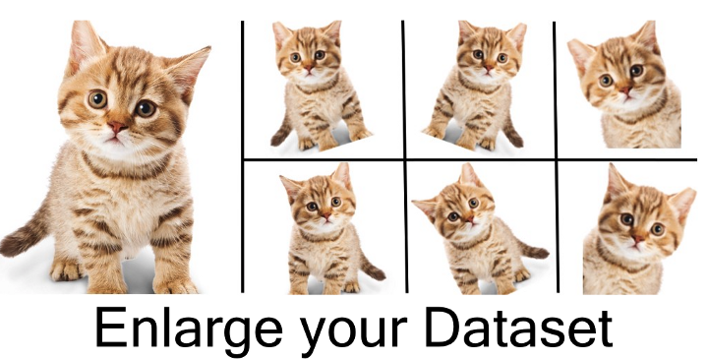
Data Augmentation
Data augmentation is a strategy that enables practitioners to significantly increase the diversity of data available for training models, without actually collecting new data.

Slide 22
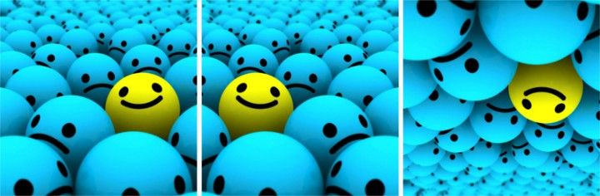
Flip

Slide 23

Rotation

Slide 24
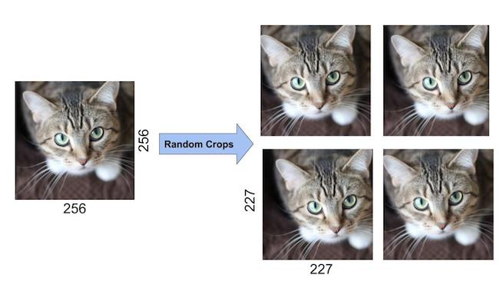
Random Cropping

Slide 25

Scaling

Slide 26
Understanding CNN End to End

Slide 27
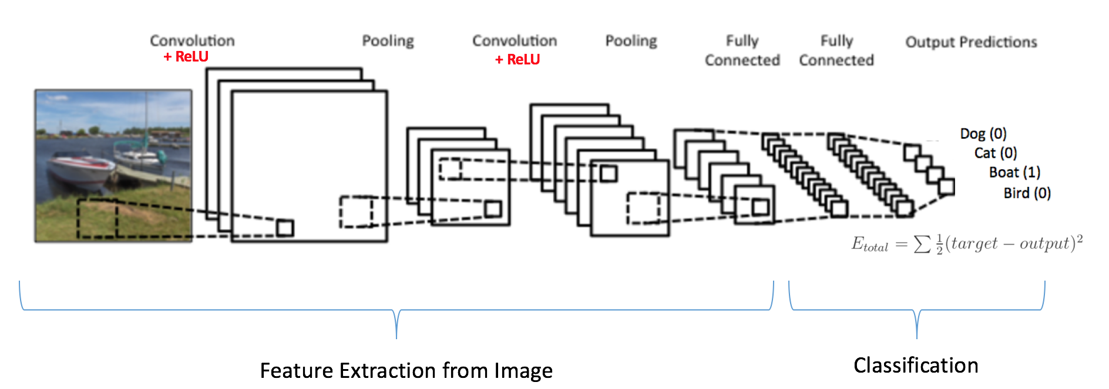
Building Convolutional Neural Network
The Building blocks of convolution networks are
The Convolutional Layer.
Pooling.
Final layers.

Slide 28
Convolutional Layer
This layer consists of “Padding”, “Convolution operation” and “Relu”.
This layer receives the image and applies padding on top of it.
Select the dimension of filter and number of filters to apply convolution operation.
Start with a filter size of 7x7 or 5x5 and the number of filters can be around 16 or 32.
The output feature map after convolution is passed into the Activation function such as Relu which will remove any negative signals.

Slide 29
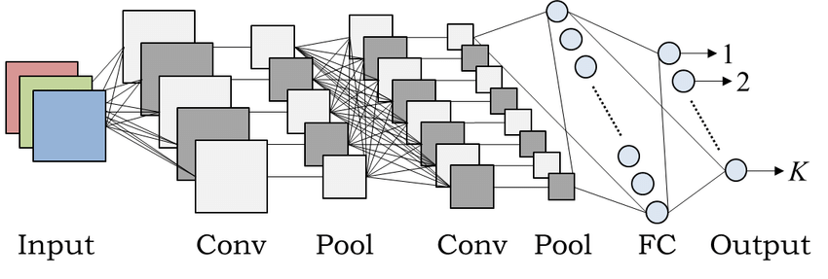
Pooling Layer
Takes in the feature map as input and reduces the size by selecting Max or Average over its size.
Pooling is generally applied over a 2x2 region.
Repeat these Convolution and Pooling layers any number of times,
Increasing parameters to learn thus increasing the size of the model.

Slide 30
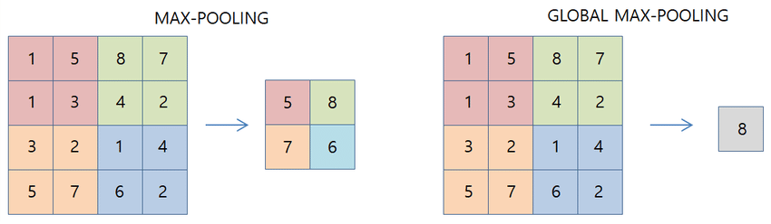
Final Layers
Assume the dimension of the feature map is 6x6x128 where 6x6 is the size of Feature and 128 is the number of filters in the 2nd convolution layer.
We cannot map a 3 dimension output directly to the output layer, so we can either Flatten the 3d vector and apply Global pooling.

Slide 31

Final Layers
Applying Global max pooling on 6x6x128 returns an output of 1x1x128 which can be treated as 128 neurons.
Add in a few Dense layers which are used to predict the output.
Select softmax or sigmoid in final layer.

Slide 32
Introduction to CNN Architectures

Slide 33
Modern CNN Architectures
Classic network architectures composed of a simple stack of convolutional layers.
Modern architectures explore new and innovative ways for constructing convolutional layers which allows for more efficient learning.
All of these architectures are based on repeatable units which are used throughout the network.
These architectures serve as rich feature extractors used for image classification, object detection, image segmentation.

Slide 34
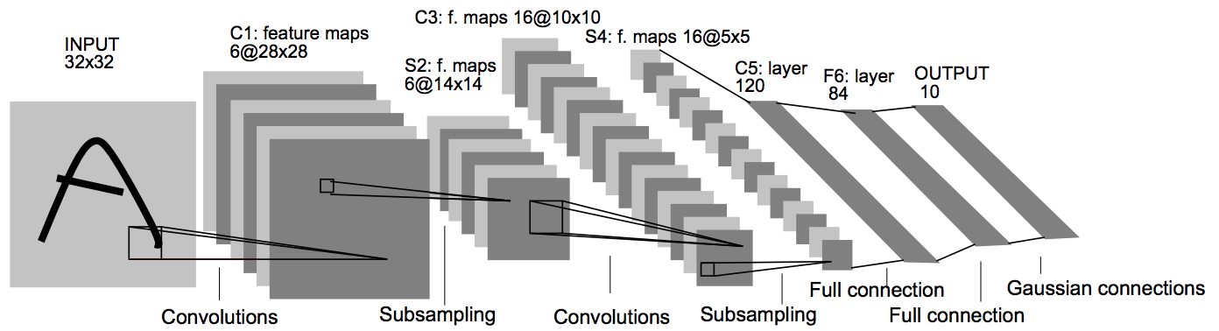
LeNet-5
Developed by Yann Lecun in 1998.
Aim of this model is to identify handwritten digits for zip code recognition in the postal service.
It consists of 3 convolutional layers , 2 average pooling layers and 2 Dense layers.

Slide 35
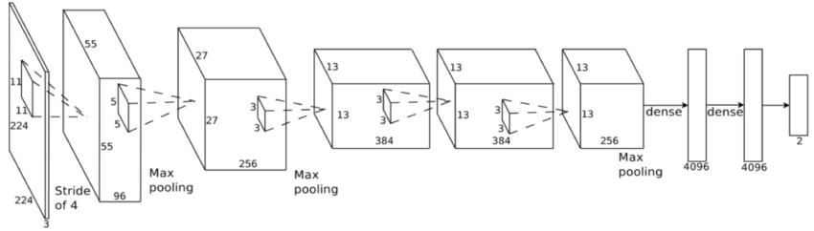
AlexNet
Developed by Alex Krizhevsky in 2012 to compete in the ImageNet.
Similar to LeNet-5.
Larger Input size and Filter size.

Slide 36

VGG
Introduced in 2014 by Karen Simonyan & Andrew Zisserman
VGG comes in two variants :
VGG 16.
VGG 19.

Slide 37
Models Review
Does increasing the number of CNN layers always improve a model's performance ? No !
The deeper convolutional structures started overfitting
Adding more layers can lead to more complex learning functions which might lead to an overfitting situation.
Deeper networks might face an issue backpropagating the gradients
Vanishing Gradients problem.

Slide 38
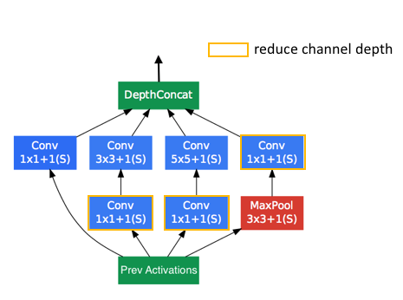
Inception Network
The researchers at Google introduced the Inception network which took first place in the 2014 ImageNet competition for classification and detection challenges.
2. Model comprises a basic unit referred to as an "Inception cell"
3. Extract features from 3 or 4 different filters with different dimensions and stack all the
extracted features together.

Slide 39
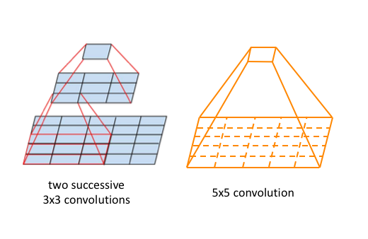
Inception Network
proved “performance and efficiency of 2 3x3 stacked filters is better than 1 5x5 filter”.
3x3 convolution operation can be executed as 3x1 followed by 1x3 convolutions which increases the efficiency of the network.

Slide 40
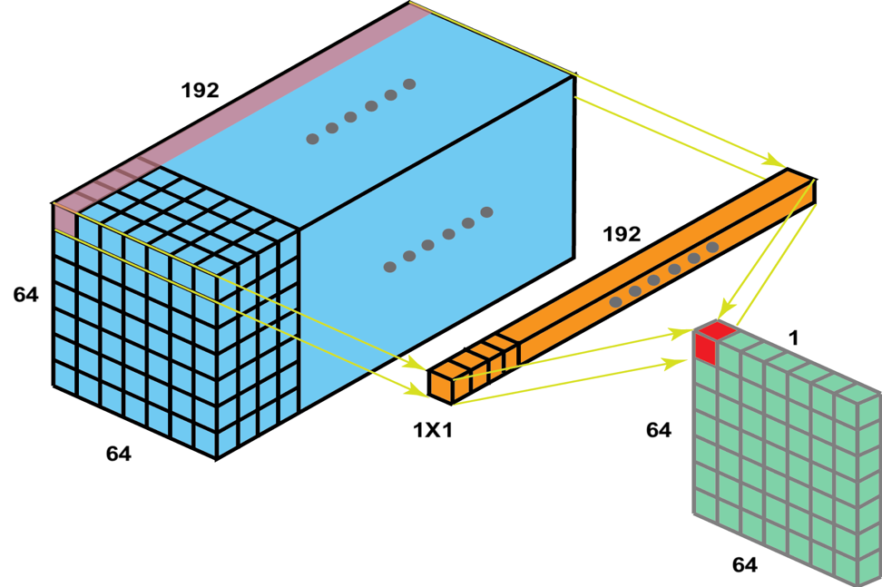
Inception Network
Introducing many filters and concatenating them would increase the size of features maps and the model would be extremely overweight.
handled this by introducing 1x1 convolutions which specifically used in decreasing the depth of feature maps.

Slide 41
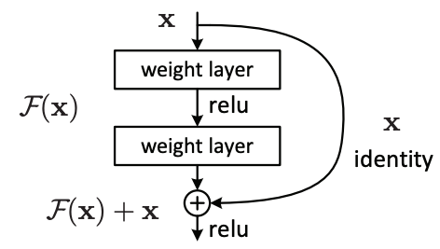
ResNet
ResNet was introduced in 2015 by Microsoft researchers
“A deep network should perform at least equal to its shallow counterparts, Consider a Network where Initial layers are the shallow network and remaining layers are Identity functions”

Slide 42
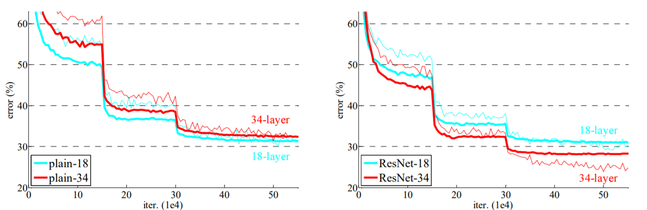
ResNet
The validation error for 34 layer resnet is significantly lower compared to its plain counterpart.
This difference will keep increasing with the increase in the number of layers.

Slide 43
Transfer Learning

Slide 44
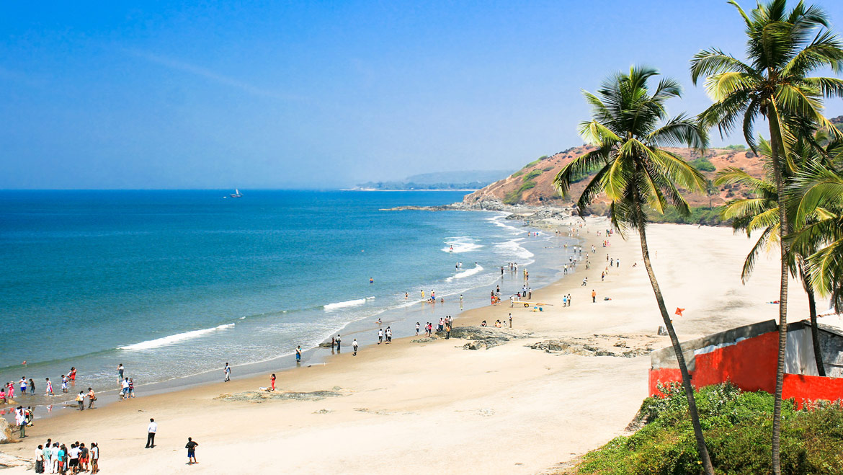
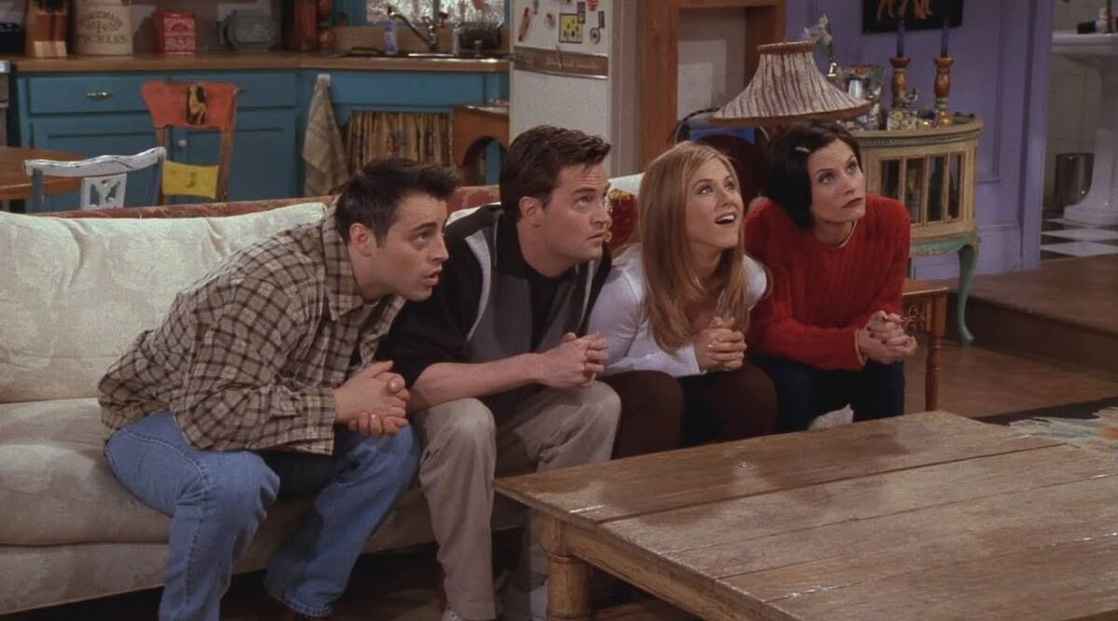
Idea behind Transfer Learning

Slide 45
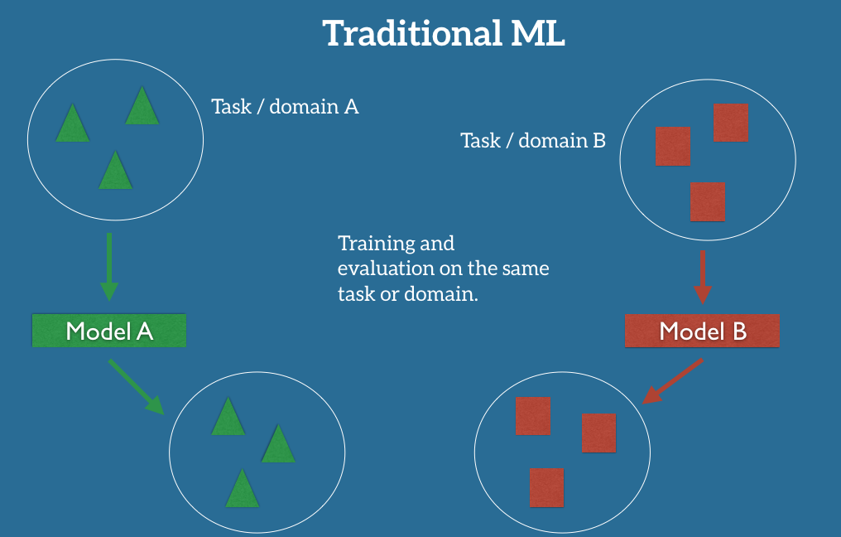
Traditional ML

Slide 46
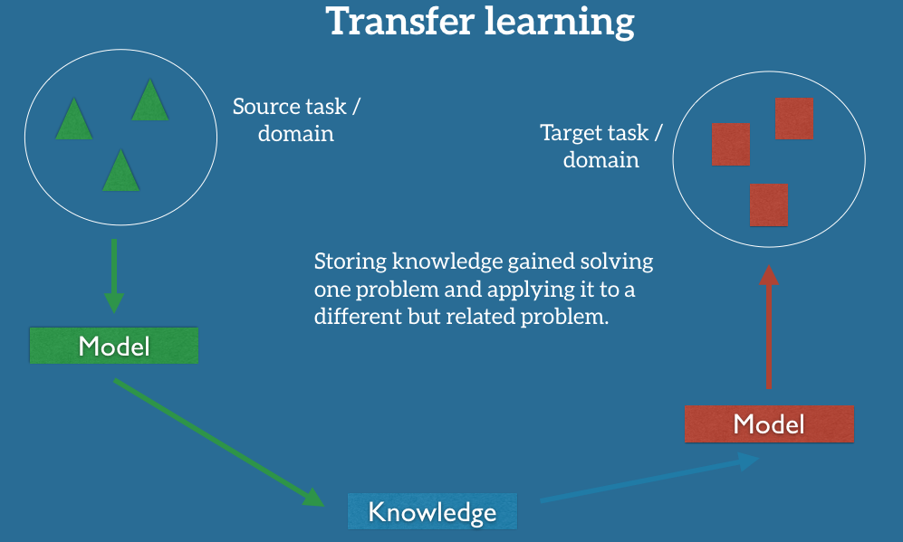
Transfer Learning

Slide 47
Advantages
Not learning features from scratch.
Starting with Random weights is the tricky part
As training started with some weights that have performed well in relevant problem statement, they have high chances of working well.
Transfer learning works even with lesser data.
Domain A and Domain B have to be correlated.

Slide 48
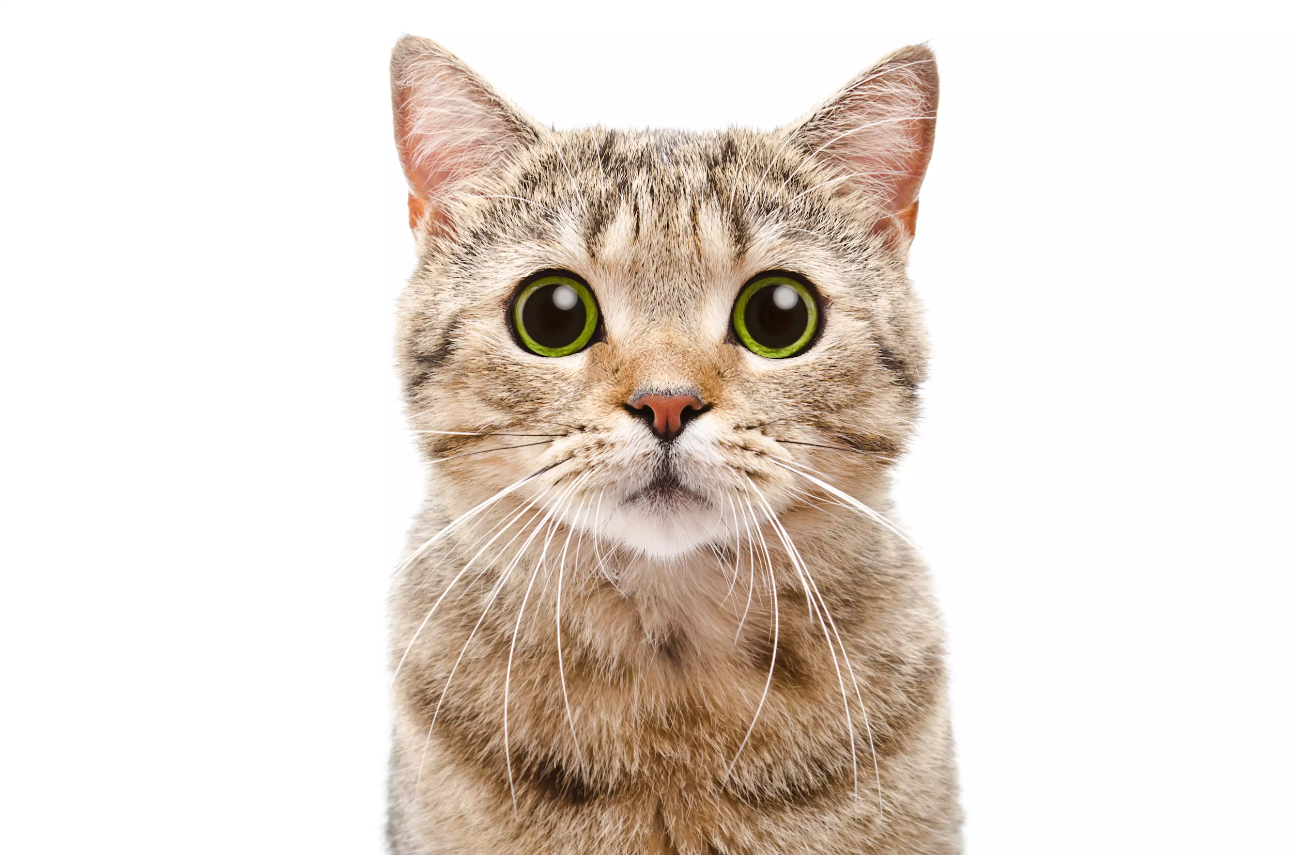
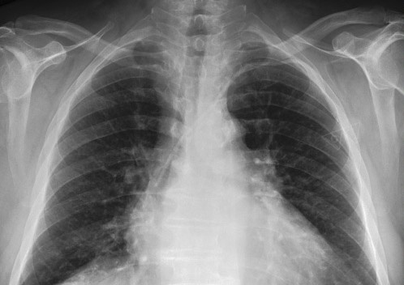
Domain and Model correlation
Domain A and Domain B have to be correlated.

Slide 49
Industry Relevance

Slide 50
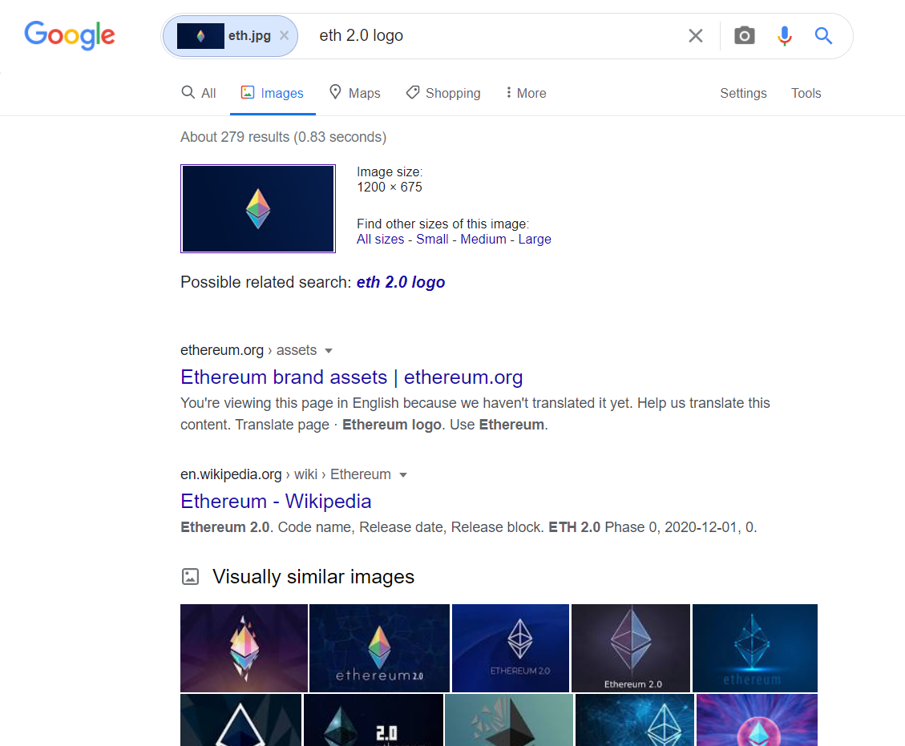
Image Based Search Engine
Generalized model extracts features from any uploaded image
These features are compared to billions of image features stored on google’s servers.
This computation is performed using advanced vectorization and parallel processing for faster outputs.

Slide 51
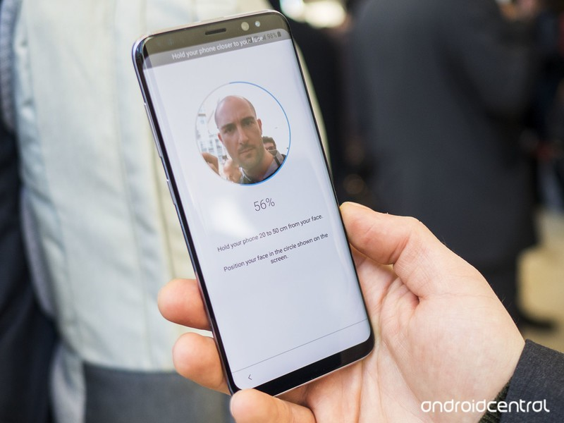
Face Recognition

Slide 52
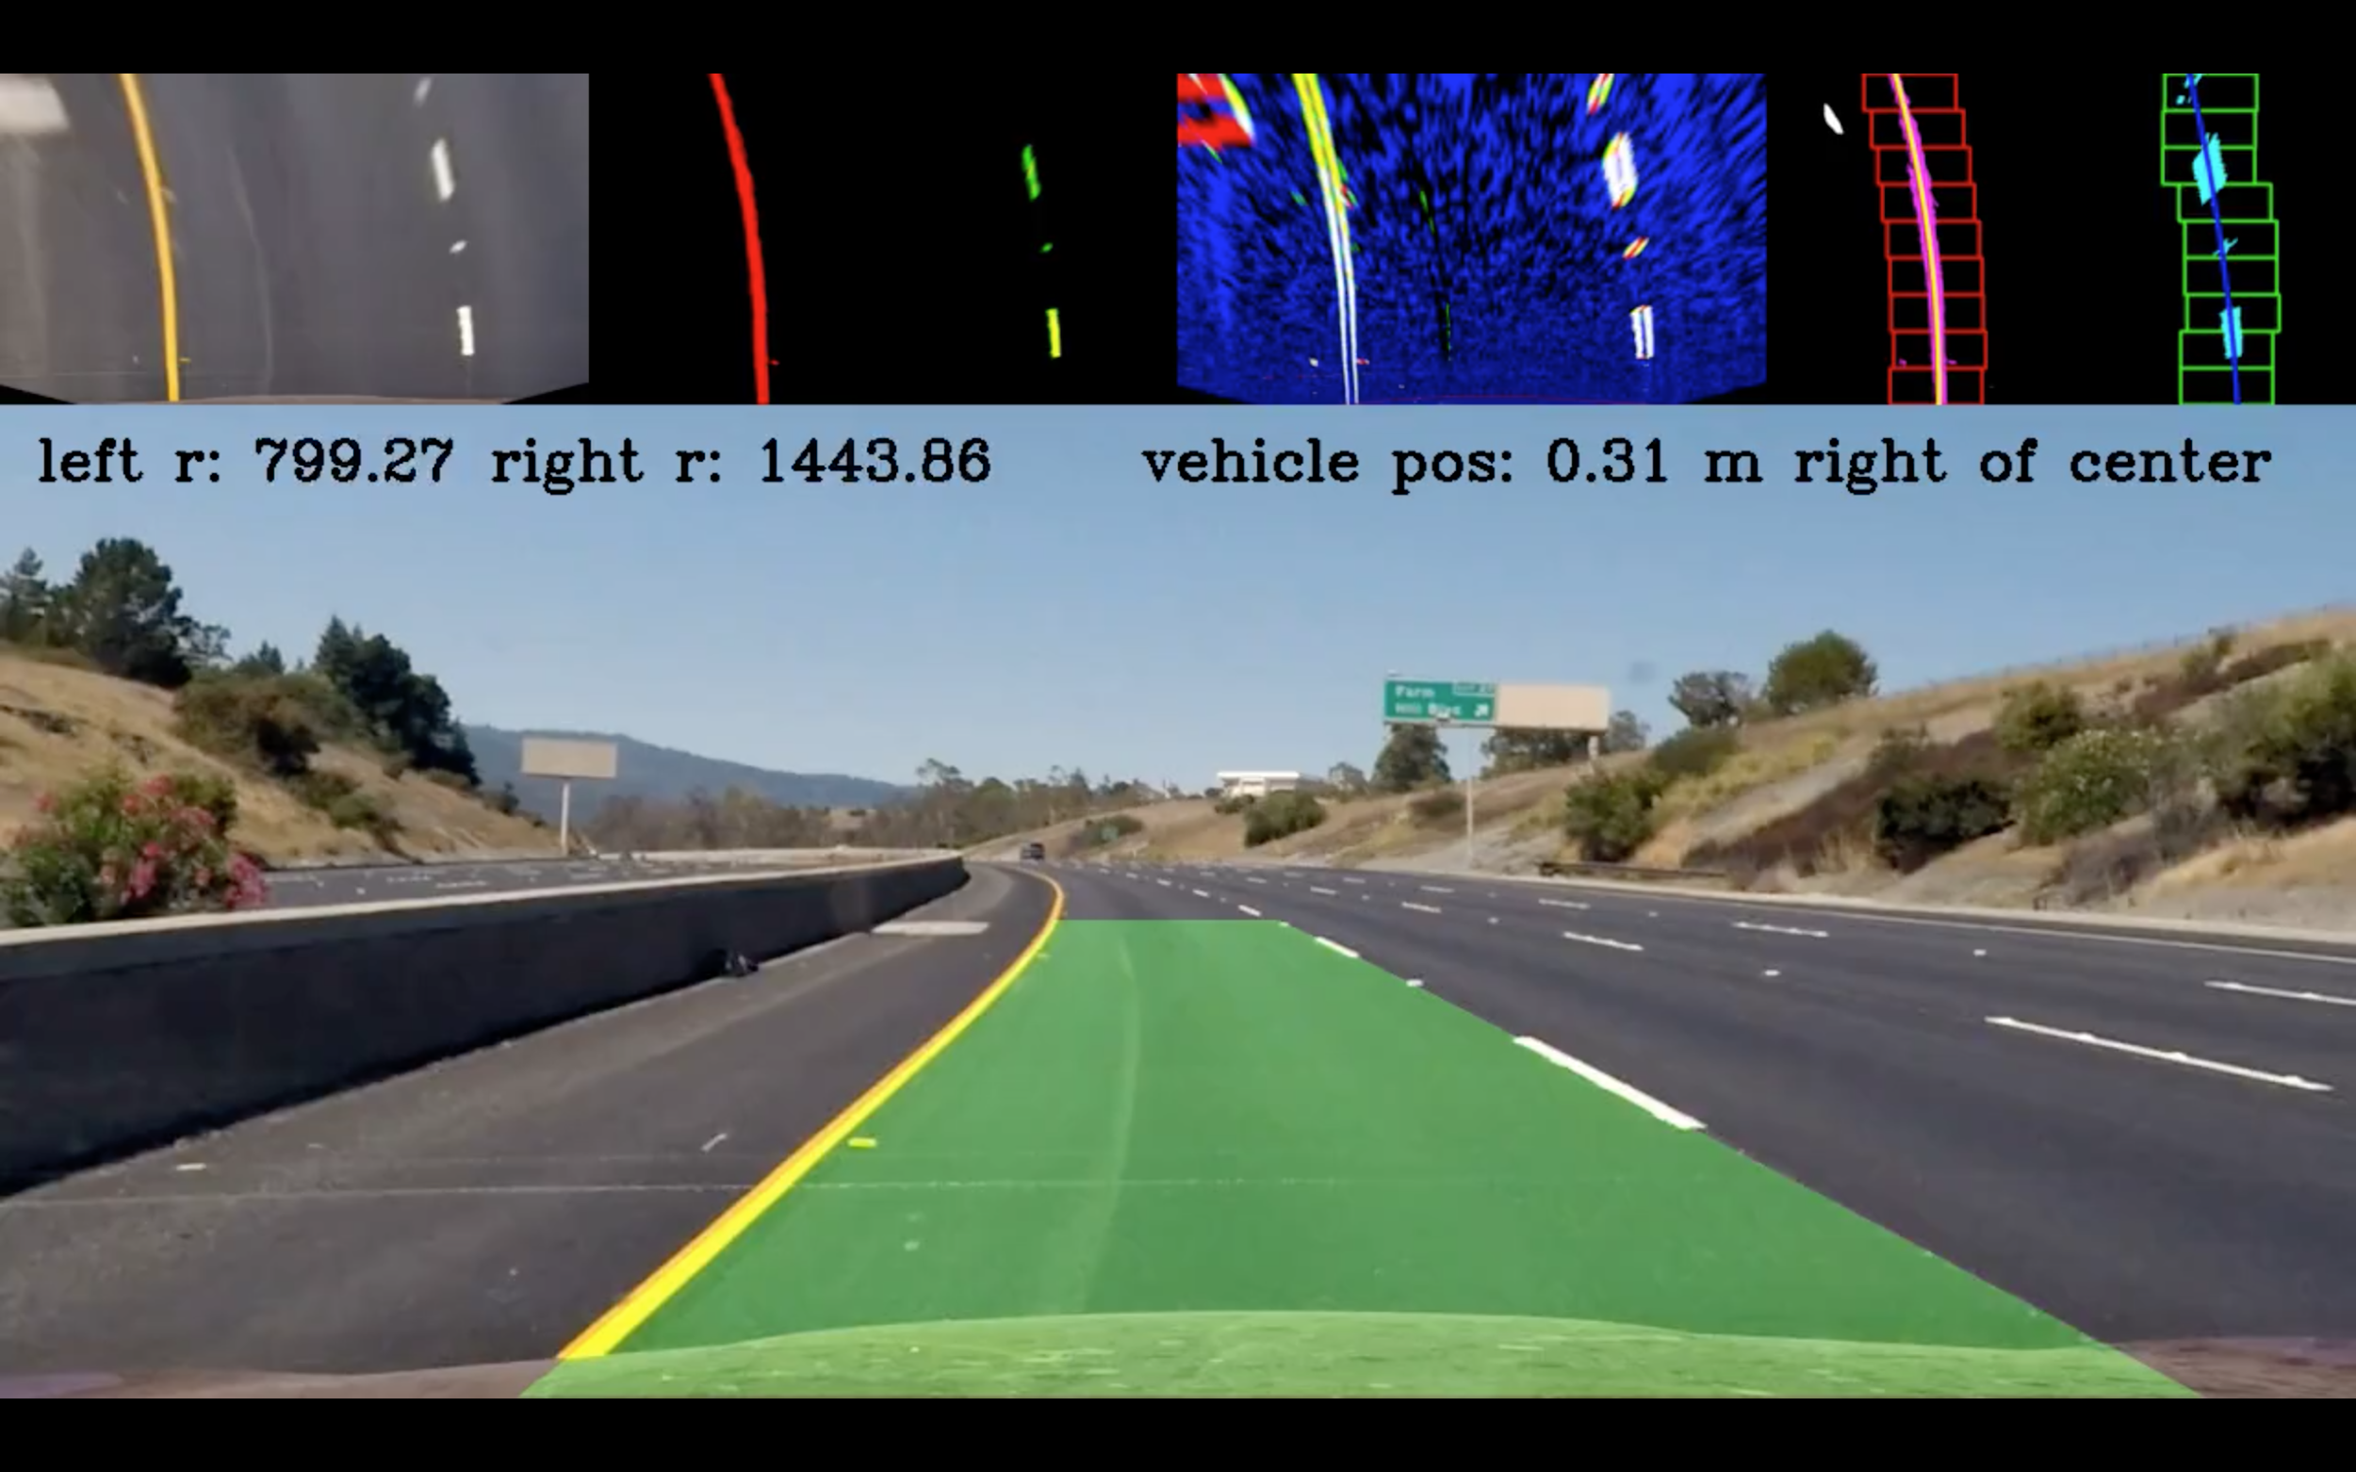
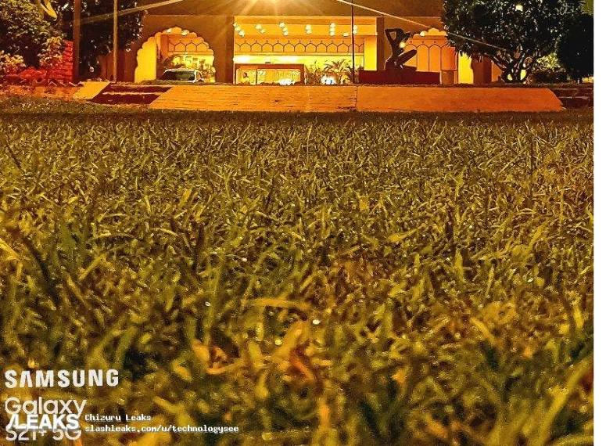
Object Detection and Masking

Slide 53
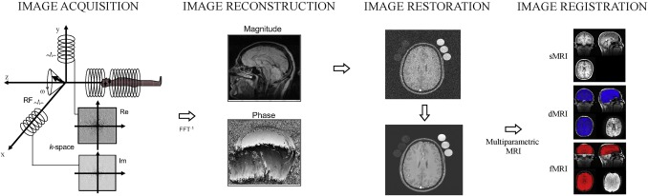
Medical Imaging
Denoise medical images.
Identify the presence of disease by looking at images.

